Slide 1
COMP2123/9123: Data Structures & Algorithms Unit Overview
Dr. Ravihansa Rajapakse
Dr. Karlos Ishac
School of Computer Science

Slide 2
Acknowledgement of Country
We would like to acknowledge the Traditional Owners of Australia and recognise their continuing connection to land, water and culture. I am currently on the land of the Gadigal people of the Eora Nation and pay my respects to their Elders, past, present and emerging.
I further acknowledge the Traditional Owners of the country on which you are on and pay respects to their Elders, past, present and future.
Notes:
For details of traditional custodians of campuses and facilities visit the intranet page below.
https://intranet.sydney.edu.au/contacts-campuses/campus-information/traditional-custodians-of-the-land.html
For other locations refer to the AIATSIS map of Indigenous Australia
https://aiatsis.gov.au/explore/articles/aiatsis-map-indigenous-australia

Slide 3
COMP9123 – Data Structurers & Algorithms
This unit is your formal introduction to algorithms and data structures, which will lay the foundations for you to come up with your own algorithms and data structures and be confident of their correctness.
Our Goal
We would like you to develop an analytical mindset with which you could approach a real-world problem. You would be able to understand suitable data structures and algorithms to address this problem and then design and test your solutions with confidence.

Slide 4
Agenda
Unit arrangement
Expectations
Assessment
Unit details
Policies
Workplace Health and Safety
Assistance
Advice

Slide 5
Places
Lecture:
Wednesday 7-9 PM
Recordings posted to canvas next day
Tutorial:
Check your timetable
Starts in Week 1
Not recorded
2nd hour works as a drop-in session
Things to keep in mind:
Go to the tutorial/lecture slot you are assigned to
Whenever possible, look at the tutorial questions beforehand

Slide 6
People
Instructors
Unit coordinator and lecturer: Dr. Ravihansa (Ravi) Rajapakse (comp9123@sydney.edu.au)
Lecturer: Dr. Karlos Ishac (comp9123 @sydney.edu.au)
TAs:
Daniel Friedrich (d.friedrich@sydney.edu.au)
Mingxiao (David) Tu (mingxiao.tu@sydney.edu.au)
Tutor: depends on your timetable

Slide 7
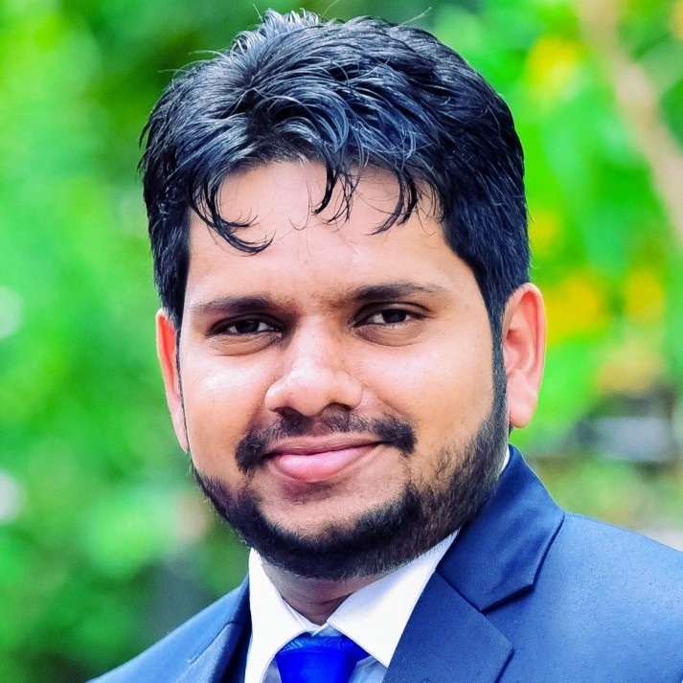
About me
Born in Sri Lanka
Lived in Australia (Brisbane, Melbourne, Sydney)
Worked in several universities
QUT, UQ, CQU, Monash, Swinburne
Joined USyd in October 2024
Hobbies
Bushwalking, travelling, movies, music, cricket (play & watch)

Slide 8
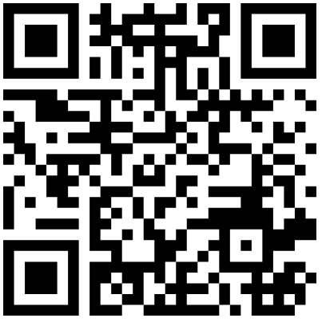
Getting to know you
Menti quiz:
https://www.menti.com/alcsw4s7yjzd

Slide 9
Resources
Canvas: https://canvas.sydney.edu.au/
Login using Unikey and password
Link to Units website: https://sydney.edu.au/units/
Official schedule, list of learning outcomes, etc.
Lecture videos
Weekly quizzes
Link to Ed:
Discussion forum
Lecture slides – for most updated version, download after the lecture
Tutorial instructions and solutions
Assignment instructions and solutions
Extra resources, including programming exercises

Slide 10
Reference book
“Algorithm Design and Applications”, by Goodrich and Tamassia; published by Wiley.
It is not required for purchase, but you may find it useful to guide your exploration of the ideas
This and other relevant works can be found in the university library
Link to “Algorithms”, by Jeff Erickson can be found on Ed

Slide 11
Expectations
Students attend scheduled classes, and devote an extra 6-9 hours per week
doing assessments
preparing and reviewing for classes
revising and integrating the ideas
practice and self-assess
Students are responsible learners
Participate in classes, constructively
Respect for one another: criticize ideas, not people
Assume good intent: we all share the same goal
Humility: none of us knows it all
Check Canvas site at least once a week!
Notify teaching staff whenever there are difficulties

Slide 12
Self-test
How much work will you be devoting to this unit, each week?
Do you need to buy a book?
Who should you contact if difficulties arise?

Slide 13
Assessment
3 assignments
Assignment 1 (Week 4 – 10%)
Assignment 2 (Week 9 – 15%)
Assignment 3 (Week 13 – 15%)
10 quizzes
Roughly every week from week 2
10% of final mark
Equally weighted
Exam
50% of final mark
in-person / supervised
School of Computer Science policy: you must get at least 40% of the marks available on the exam, in order to pass the unit

Slide 14
Tutorials
We will post a tutorial sheet with exercises covering that week’s material.
To get the most out of the tutorial, try to solve as many problems as you can before the tutorial. Your tutor is there to help you get unstuck, not to lecture.
After all tutorials of a given week are over, we will post solutions to selected exercises.

Slide 15
Communication
Email is an inefficient way to communicate in large classes such as ours. Unless yours is a personal issue, do not send us email.
Response time for emails would be 48 hrs - excluding after working hours, weekends, and public holidays
If you have questions about the lecture materials, homework assignments, or any logistics related to the class, please use the Ed discussion forum so that others can benefit from the answers.
Finally, if you spot a question that you know the answer for, please feel free to answer. It helps your classmates but more importantly, writing your thoughts down helps you crystalize your understanding.

Slide 16
Ed etiquette
When asking questions:
Try to get unstuck first: googling your problem and/or reading our guides should solve most technical issues
Use Ed’s search function to see if it’s been answered before
When asking a new question:
Add a descriptive title
Select the correct tag, e.g. questions about Quiz 4 should be tagged with Quizzes → Q4.
Describe what you’ve already tried to solve the problem
Don’t just take a screenshot and say "what does this mean?"
If you figure it out on your own, answer your own question

Slide 17
Ed expectations
We have limited resources for monitoring Ed, which means that some questions will have to wait until the tutorial.
Do not expect any responses outside of working hours (Mon-Fri 9am-5pm) and on weekends and public holidays.
In order to answer as many questions as possible, our answers will be short and to-the-point or just a simple endorsement
SLA is 1 week; don’t expect synchronous conversation

Slide 18
Simple Extension
If your performance on assessments is affected by illness or misadventure
Please don’t apply through the University process, as I don’t need hundreds of emails for every assignment

Slide 19
Special Consideration (University policy)
If your performance on assessments is affected by illness or misadventure
Follow proper bureaucratic procedures
Have professional practitioner sign special USyd form
Submit application for special consideration online, upload scans
Note you have only a quite short deadline for applying
http://sydney.edu.au/current_students/special_consideration/
Also, notify coordinator by email as soon as anything begins to go wrong
There is a similar process if you need special arrangements e.g. for religious observance, military service, representative sports

Slide 20
Late submissions
Suppose you hand in work after the (simple extension) deadline:
If you have not been granted special consideration or arrangements
A penalty of 5% of the available marks will be taken, per day (or part) late for the first 2 days, after that your mark becomes 0
E.g. your work would have scored 60% and is 1 hour late
you get 55%
E.g. your work would have scored 70% and is 1 day 23 hours late
you get 60%
Warning: submission sites get very slow near deadlines
Submit early; you can resubmit if there is time before the deadline

Slide 21
Academic Integrity (University policy)
“The University of Sydney is unequivocally opposed to, and intolerant of, plagiarism and academic dishonesty.
Academic dishonesty means seeking to obtain or obtaining academic advantage for oneself or for others (including in the assessment or publication of work) by dishonest or unfair means.
Plagiarism means presenting another person’s work as one’s own work by presenting, copying or reproducing it without appropriate acknowledgement of the source.” [from site below]
http://sydney.edu.au/elearning/student/EI/index.shtml
Submitted work is compared against other work (from students, the internet, etc.)
TurnitIn for textual tasks (your document needs to be scannable, i.e., answers stored as text and no handwriting), other systems for code
Penalties for academic dishonesty or plagiarism can be sever and can delay the release of your result at the end of the semester

Slide 22
Academic Integrity Practice
School of Computer Science

Slide 23


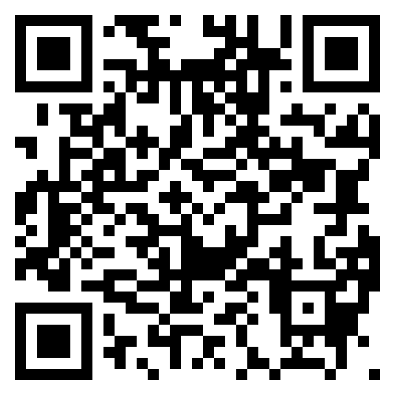


Understanding your academic integrity responsibilities
Academic integrity refers to behaving honestly, ethically and responsibly in relation to all elements of your study at the University, including assessments.
It's important that you:
Always submit your own work, sit your own tests, and take your own examinations.
Acknowledge any contributions in your assignment which are not your original thoughts, ideas or words.
Complete the Academic Honesty Education Module (AHEM), which all new students must complete by census date (31 March 2025).
Listen to your coordinator's instructions on whether digital tools, including grammar checkers and generative AI, are allowed in assessments.
Complete the AHEM
Notes:
Overview
The core values that underpin the concept of academic integrity are honesty, trust, fairness, respect and responsibility.
At university, behaving with academic honesty means doing your own work even if you find the work challenging. This means that you do not try to benefit academically by misleading or being unfair to others.
Academic integrity is embedded into every area of study and research at the University. It is important that you understand the expectations of acknowledging sources within your disciplines to avoid plagiarism, learn how to detect and deter contract cheating opportunities and work with groups in legitimate ways when required to do so.
If you are a commencing student, please make sure you complete the Academic Honesty Education Module in Canvas by the census date.
If you are a continuing student and would like a refresher, you can self-enrol in the module which has recently been updated.
Be alert to contract cheating companies, (which sometimes call themselves 'tutoring' companies, 'homework helpers', 'exam assistance', 'essay writing service'). They target uni students online and in-person. They promise they’ll help you get good grades – but they are not licensed education providers and are illegal under Australian law. Using their services can even result in blackmail and can jeopardise your online privacy. Using their services also attracts penalties from the University.
It is also important to understand the University’s guidelines for using generative AI tools (see next page).
More information
For a more detailed overview, teaching staff can go through a separate slide pack available here: https://intranet.sydney.edu.au/content/dam/intranet/documents/teaching-support/teaching-resources/academic-integrity-slides.pptx

Slide 24
Source of Help
Lecturer | Teaching Assistants / Tutors | Classmates | Private tutors | Online forums/ Online tutors/ ChatGPT | Students outside course/UoS | Hired coders Tutorial Company outside University | Relatives | Other
Individual assessment
A student needs to gain an understanding of fundamental knowledge/skills
It is important to master the knowledge/skills themselves
Posting or using answers from Chegg, Geeks for geeks, etc. is cheating
Encouraged
Attribution required
Not acceptable
Ask Lecturer/Coordinator

Slide 25
Types of Help
Understanding General Concepts | Explained using similar material (not assignment) | Sharing approach/concept to derive assignment solution | Designing code/solution | Implementing code/solution
Individual assessment
A student needs to gain an understanding of fundamental knowledge/skills
It is important to master the knowledge/skills themselves
Students are encouraged to obtain help through relevant teaching material and practices but not directly on assessment materials
Using any text verbatim without attribution (except from our slides) is plagiarism
Encouraged
Attribution required
Not acceptable
Ask Lecturer/Coordinator

Slide 26

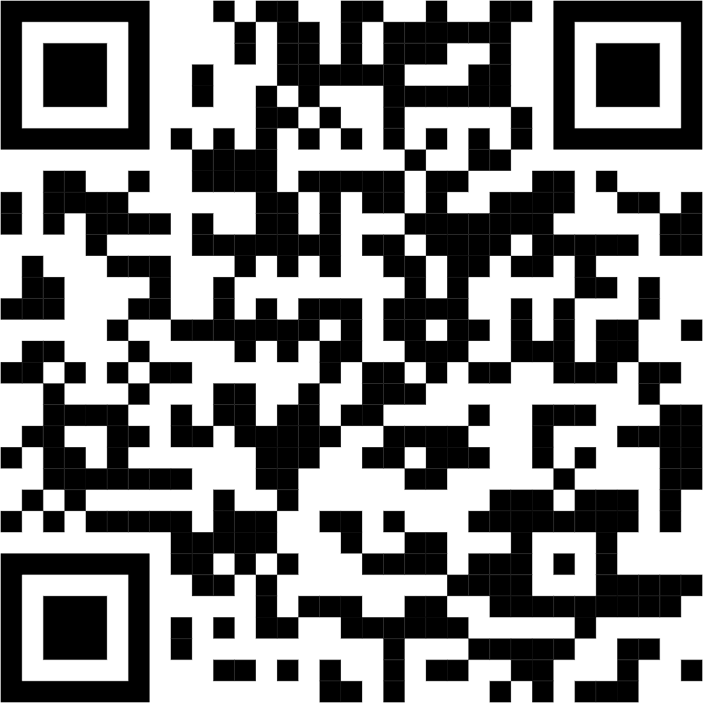

Using generative AI
Generative AI tools, such as Microsoft Copilot Chat, can create digital content, including text, images, and video​. Different guidelines for use of generative AI apply to learning and assessment:
Generative AI for general learning
You can use generative AI to help you learn. For example, it can explain things, apply knowledge, plan your study and make practice questions.​ Use our student co-designed AI resource so you are aware of its strengths and limitations.
Generative AI for assessment​
Exams and in-semester tests: you cannot use generative AI in supervised exams or in-semester tests, unless your unit coordinator expressly allows it.
Other assessments: you can use generative AI, unless your unit coordinator expressly prohibits it.
Always acknowledge your AI use. Failing to do so, or using AI when not permitted, is an academic integrity breach.
Each unit will have different rules. Look for the AI icons in the assessment table in your unit outlines to see if AI is allowed.
AI resource made by students: https://bit.ly/students-ai
Notes:
Overview
At the University of Sydney we want to equip students to use generative artificial intelligence productively and responsibly as part of your learning journey. Different guidelines apply to using generative AI in learning and assessment.
Learning is your experience in understanding the subject matter of the unit e.g. to help you prepare for an upcoming class, or assist you during class to understand discussion. You can use generative AI to help you learn.
Assessment includes any part of the unit for which you are obligated to submit a piece of work. This includes examinations, assignments, and other assessable work that enables students to monitor their progress and contributes to their academic results in a unit of study. Your unit coordinator will let you know whether use of generative AI tools is permitted for assessment purposes. If your unit coordinator has not addressed use of generative AI, you are permitted to do so for the purposes of assessment, except for tests and exams
More information for teaching staff
Contact your coordinator for unit-specific guidelines to share with students. More information on the intranet at: https://intranet.sydney.edu.au/teaching-support/academic-integrity/artificial-intelligence-and-assessment.html

Slide 27
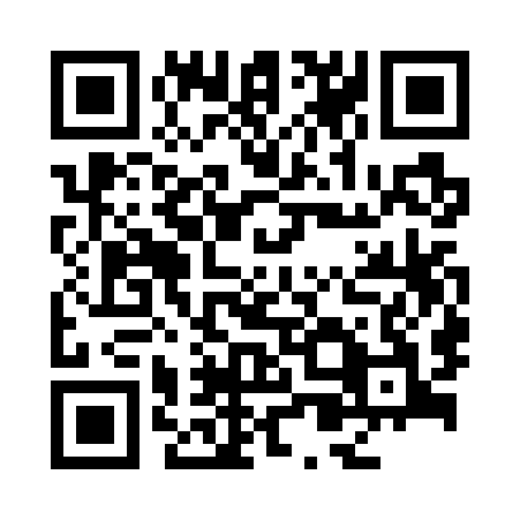
Which generative AI tools are best to use?
The University provides free access to Microsoft Copilot Chat to accelerate your learning and help you complete those assessments where use of generative AI is allowed.
Why use Microsoft Copilot Chat?
It is a University-supported, industry standard, GPT-4 powered tool
It keeps your data secure and protects your privacy
Log in with your UniKey using Okta so that you are using Copilot in protected mode, which introduces necessary guardrails to protect you within the system
Why not use other tools like ChatGPT and DeepSeek?
Don’t risk your privacy or the security of your personal and assessment data by using a free or emerging tool like ChatGPT and DeepSeek
Powerful and secure
https://copilot.microsoft.com/

Slide 28
Self-test
When is the first assignment due?
What do you do if you get sick during semester?
What help can you use when answering assessments?
How do you find out about assignment instructions?
How do you submit your work?
What is TurnitIn?

Slide 29
Completing your mandatory Canvas modules
We've developed a series of Canvas modules to help you understand what to expect from the University and what is expected from you. They include:
Respect@Sydney, designed to give you an understanding of consent, boundaries and respectful relationships (mandatory for commencing students).
Academic Honesty Education Module (mandatory for commencing students).
Engaging with Civility, a module where you can unpack the values and expectations outlined in our Student Charter, including information about penalties for breaching our codes of conduct and displaying threatening, discriminatory or racist behaviour.
Anti-Slavery Awareness Module.
Many of these modules are mandatory for commencing students and your results may be withheld if you do not complete them.
Notes:
There are a series of Canvas modules that have been designed to ensure that you have a smooth and enjoyable University experience. Many of these will appear in your Canvas dashboard automatically. It is important that you complete these modules so that you understand what you can expect from the University, and what we expect from you. Some of these modules are also mandatory for commencing students and if they are not completed, your results may be withheld at the end of the semester.

Slide 30
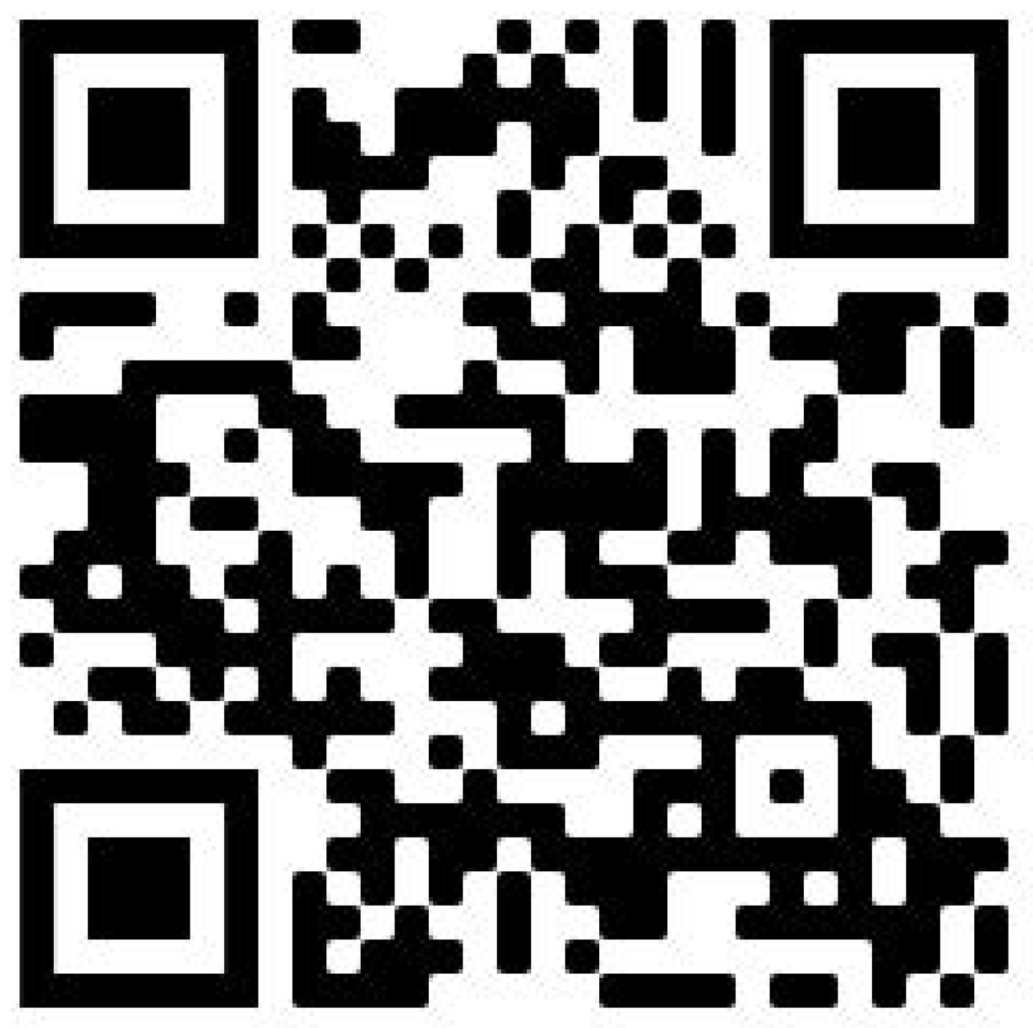

Student support
Visit the Student life, wellbeing and support webpage to find out about the student services, resources and events available to support you while you study:
Health and wellbeing
Academic Support
Personal support
Getting connected
Questions about getting started this semester? Come visit us at a Welcome Hub
Anderson Stuart Welcome Hub
Carslaw West Welcome Hub
Notes:
No matter what kind of help you need, the University is here to support you.
Visit the website to find out what is available to you.
Scan the QR code to access the website.

Slide 31
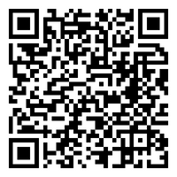
Safer Communities Office
Support and case management for people who have experienced sexual misconduct, domestic/family violence, bullying/harassment or issues relating to modern slavery.
Contact the team
8:30 am to 5:30 pm Monday to Friday, Sydney local time
phone: +61 2 8627 6808
email: safer-communities.officer@sydney.edu.au
campus: Level 5, Jane Foss Russell building, City Road, Darlington Campus
Make a report
Visit the website to make a complaint or disclosure of sexual misconduct to the University.
Notes:
Students have let us know through the National Student Safety Survey that it can be hard to find information on where to find support or how to make a report for experiences of sexual misconduct.
Here is some more information about our Safer Communities Office, which has specialist staff experience in responding to people who have experienced sexual misconduct and other trauma.

Slide 32





General Housekeeping – Use of Labs
Keep work area clean and orderly
Remove trip hazards around desk area
No food and drink near machines
No smoking permitted within University buildings
Do not unplug or move equipment without permission

Slide 33
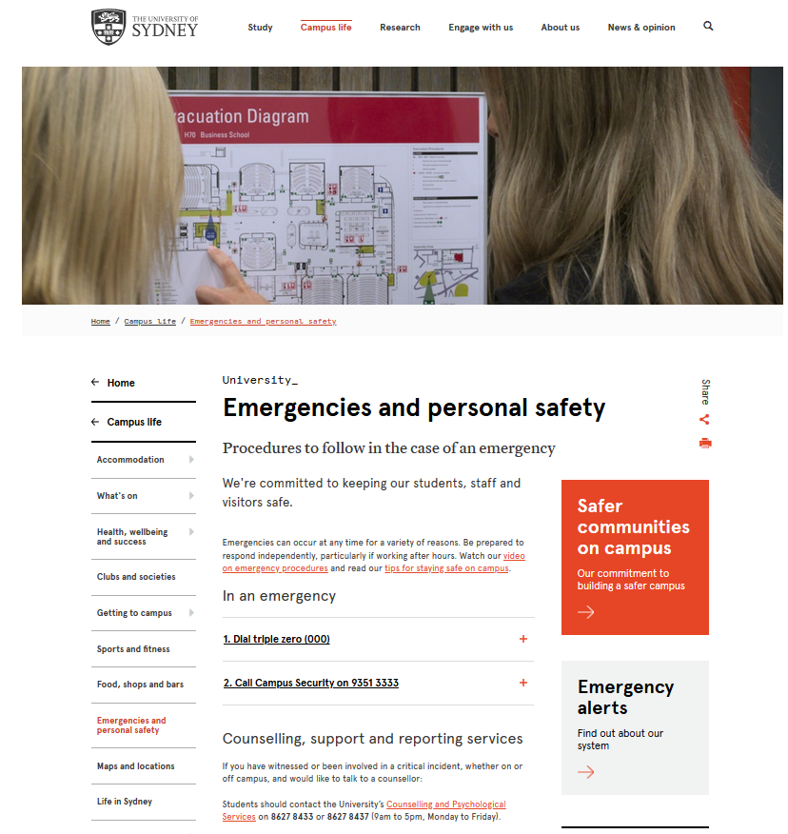
EMERGENCIES – Be prepared
https://sydney.edu.au/campus-life/safety-security.html

Slide 34
Assistance
There are a wide range of support services available for students: https://sydney.edu.au/campus-life/health-wellbeing-success.html
Please make contact, and get help
You are not required to tell anyone else about this
If you are willing to inform the unit coordinator, they may be able to work with other support to reduce the impact on this unit
E.g. provide advice on which tasks are most significant

Slide 35
Disability Services
Do you have a disability?
You may not think of yourself as having a ‘disability’ but the definition under the Disability Discrimination Act is broad and includes temporary or chronic medical conditions, physical or sensory disabilities, psychological conditions and learning disabilities.
The types of disabilities we see include:
anxiety, arthritis, asthma, asperger's disorder, ADHD, bipolar disorder, broken bones, cancer, cerebral palsy, chronic fatigue syndrome, crohn’s disease, cystic fibrosis, depression, diabetes, dyslexia, epilepsy, hearing impairment, learning disability, mobility impairment, multiple sclerosis, post traumatic stress, schizophrenia , vision impairment, and much more.
Students needing assistance must register with Disability Services –
it is advisable to do this as early as possible.
https://www.sydney.edu.au/students/health-wellbeing/inclusion-and-disability.html

Slide 36
Disability Services Office sydney.edu.au/disability 02-8627-8422
Do you have a disability?
You may not think of yourself as having a ‘disability’ but the definition under the Disability Discrimination Act (1992) is broad and includes temporary or chronic medical conditions, physical or sensory disabilities, psychological conditions and learning disabilities.
The types of disabilities we see include:
Anxiety // Arthritis // Asthma // Autism // ADHD
Bipolar disorder // Broken bones // Cancer
Cerebral palsy // Chronic fatigue syndrome
Crohn’s disease // Cystic fibrosis // Depression Diabetes // Dyslexia // Epilepsy // Hearing impairment // Learning disability // Mobility impairment // Multiple sclerosis // Post-traumatic stress // Schizophrenia // Vision impairment
and much more.
Students needing assistance must register with Disability Services. It is advisable to do this as early as possible. Please contact us or review our website to find out more.

Slide 37
Other support
Learning support
http://sydney.edu.au/study/academic-support/learning-support.html
International students
http://sydney.edu.au/study/academic-support/support-for-international-students.html
Aboriginal and Torres Strait Islanders
http://sydney.edu.au/study/academic-support/aboriginal-and-torres-strait-islander-support.html
Student organization (can represent you in academic appeals etc)
http://srcusyd.net.au/ or http://www.supra.net.au/
Please make contact, and get help
You are not required to tell anyone else about this
If you are willing to inform the unit coordinator, they may be able to work with other support to reduce the impact on this unit
eg provide advice on which tasks are most significant

Slide 38
Advice
Metacognition
Pay attention to the learning outcomes in Canvas
Self-check that you are achieving each one
Think how each assessment task relates to these
Time management
Watch the due dates
Start work early, submit early
Networking and community-formation
Make friends and discuss ideas with them
Know your tutor, lecturer, coordinator
Keep them informed, especially if you fall behind
Don’t wait to get help
Enjoy the learning!

